Slide 1
Full Stack Web Development
by Piyush Bagla

Slide 2
Why HTML 5.0 ?
Internet
ARPANET
Hypertext
SGML
HTML
WWW
W3C
WHATWG
HTML 5.0

Slide 3
Internet
- The Internet is a global network of interconnected computer networks that communicate using standardized protocols.
- The Internet provides the infrastructure for transmitting data between devices and networks worldwide.
- The WWW operates on top of the Internet, leveraging its infrastructure to connect web servers and clients, enabling the exchange of hypertext documents (web pages) between users and servers.

Slide 4

History of Internet

Slide 5


Slide 6
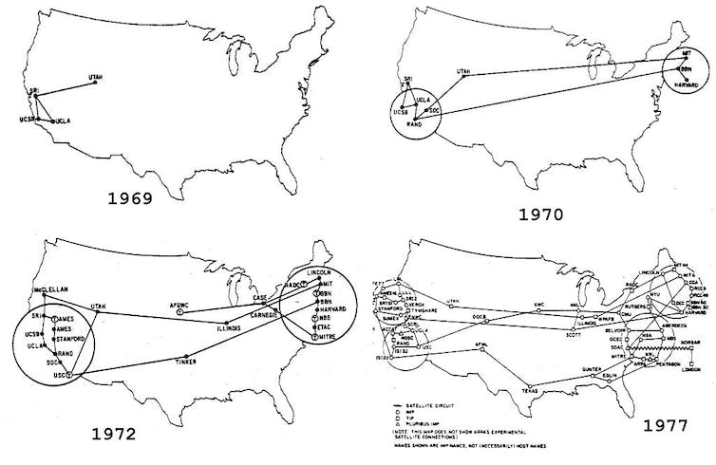
ARPANET

Slide 7
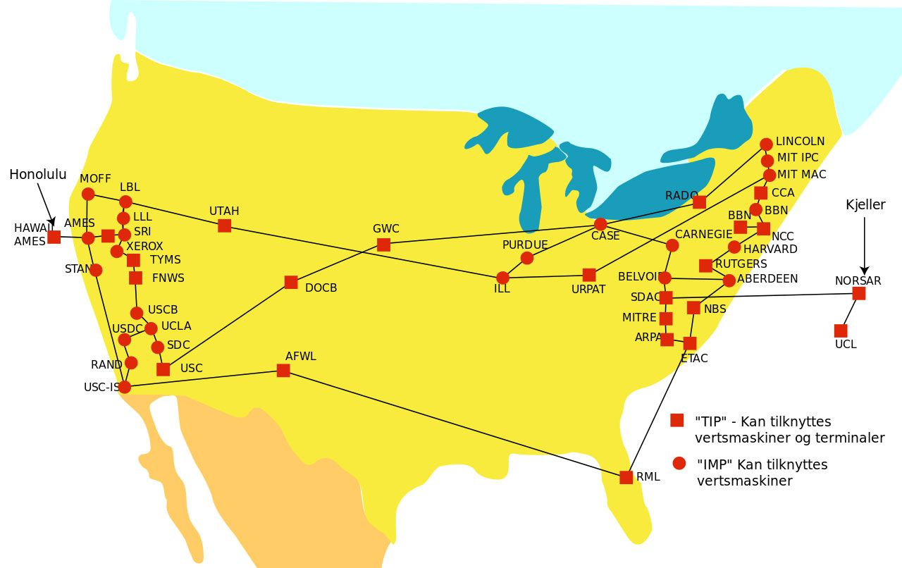

Slide 8
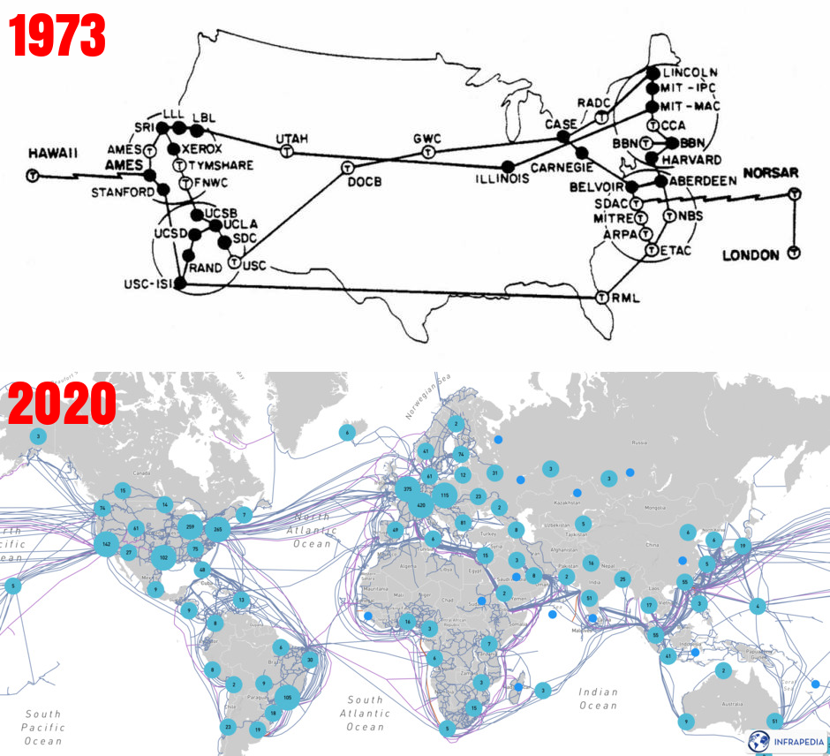

Slide 9
Hypertext
- Hypertext is a concept of organizing and linking text documents electronically, allowing users to navigate between related pieces of information through hyperlinks.
- Hypertext enables non-linear navigation, where users can jump from one document to another by clicking on hyperlinks embedded within the text.

Slide 10
SGML
- SGML stands for Standard Generalized Markup Language. It's used for defining the structure and attributes of documents.
- SGML serves as a framework for defining other markup languages and has been influential in developing various document formats and standards.
- SGML allows users to define the hierarchical structure of documents, specify elements and attributes, and establish relationships between different parts of the document. SGML-aware software can then process these documents to extract, manipulate, or present the information contained within them.

Slide 11
SGML Application Areas
In the publishing industry, SGML has been used to define the structure of technical documentation, such as user manuals for complex machinery or equipment.
The aerospace industry has extensively used SGML for creating structured documentation, such as aircraft maintenance manuals.
In the healthcare industry, SGML could be used to define the structure of electronic medical records (EMRs)

Slide 12
HTML
- HTML provided a standardized markup language specifically designed for creating hypertext documents for the World Wide Web.
- HTML provides a standardized way to structure and format hypertext documents for the web, using tags to define elements such as headings, paragraphs, images, and hyperlinks.
- HTML tags allow content creators to embed hyperlinks within web pages, enabling users to navigate between different documents on the web.

Slide 13
World Wide Web
- The WWW is a system of interlinked hypertext documents accessed via the Internet.
- The WWW was invented by Tim Berners-Lee in 1989 as a decentralized system for sharing and accessing hypertext documents (web pages) globally.
- Hyperlinks within web pages allow users to navigate between different documents on the web, creating a network of interconnected information.

Slide 14
Link Between Them
- Hypertext laid the conceptual groundwork for linking text documents electronically, enabling non-linear navigation between related pieces of information.
- HTML provided the language and structure for creating hypertext documents within the framework of the WWW, allowing content creators to embed hyperlinks within web pages.
- The WWW combined hypertext with standardized protocols like HTTP (Hypertext Transfer Protocol) and URLs (Uniform Resource Locators) to create a decentralized system for sharing and accessing hypertext documents (web pages) via the Internet.
- The Internet provides the underlying infrastructure for transmitting data between devices and networks, enabling the exchange of hypertext documents between users and servers worldwide.

Slide 15
W3C
-The consortium formed in 1994 by Tim and it focused on establishing foundational standards for the web, including HTML, HTTP, and URLs
-This included specifications for markup languages (HTML, XML), style sheet languages (CSS), document object models (DOM), and web accessibility guidelines (WCAG).
- The W3C's work helped establish a common framework for web development and ensured the compatibility of web technologies across different platforms and devices.

Slide 16
WHATWG
-The WHATWG was formed in 2004 by individuals from Apple, Mozilla, and Opera in response to perceived slow progress in web standards development at the W3C.
-At that time, the W3C was focusing on XHTML 2.0, which was seen by some as diverging from the practical needs of web developers. The WHATWG aimed to address this gap by focusing on developing specifications that reflected the needs of the modern web.
-Formed HTML 5.0 in collaboration with W3C

Slide 17
HTML 5.0 Predecessors
+--------------+--------------------------------+----------------+----------------------------------------+
| HTML Version | Development Body | Year Published
+--------------+--------------------------------+----------------+----------------------------------------+
| HTML 1.0 | Tim Berners-Lee at CERN | 1991
| HTML 2.0 | Internet Engineering Task Force | 1995
| HTML 3.2 | W3C | 1997
| HTML 4.01 | W3C | 1999
| XHTML | W3C | 2000
| HTML5 | W3C & WHATWG | 2008 (Ongoing)
+--------------+--------------------------------+----------------+----------------------------------------+

Slide 18
Comparison of HTML 5 Elements with previous versions
HTML Version | Elements Added
HTML 1.0 | It was the initial version that laid the groundwork for subsequent versions to build upon.
HTML 2.0 | <img>, <form>, <input>, <textarea>, <select>, <button>, <ol>, <ul>, <li>, <table>, <tr>, <td>, <th>
HTML 3.2 | <embed>, <iframe>, <font>
HTML 4.01 | <meta>, <link>, <script>, <div>, <span>
XHTML 1.0 | Same elements as HTML 4.01 but reformulated in XML syntax
HTML5 | <header>, <nav>, <section>, <article>, <aside>, <footer>, <audio>, <video>, <canvas>, <svg>, <details>, <summary>, <progress>, <meter>, <datalist>, <output>, <time>, <mark>, <meter>, <progress>, <ruby>, <rt>, <rp>, and many more

Slide 19
Feature | HTML (Previous Versions) | HTML5
Doctype Declaration | Various doctypes for HTML 4.01, XHTML 1.0, etc. | Simplified to <!DOCTYPE html> for HTML5
Structural Elements | Limited semantic elements (<div>, <span>, <table>, etc.) | Rich set of semantic elements (<header>, <nav>, <section>, <footer>, etc.)
Multimedia Support | Rely on third-party plugins like Flash or Silverlight | Native <audio> and <video> elements
Canvas | Not available | <canvas> element for dynamic graphics
Forms Enhancements | Limited input types and attributes, rely on JavaScript for validation | New input types (email, url, date, number, etc.) and form validation attributes (required, pattern, etc.)
Local Storage | Rely on JavaScript cookies (eg. Lang of webpage) | localStorage and sessionStorage APIs for client-side storage

Slide 20
Feature | HTML (Previous Versions) | HTML5
Geolocation | Not available | Geolocation API for retrieving user's location
Drag and Drop | Not available | Native Drag and Drop API for dragging and dropping elements
Offline Application Cache | Not available | Application Cache API for offline web applications (eg calculator, note-taking application)
Web Workers | Not available | Web Workers API for running scripts in background threads (eg. Image processing)

Slide 21
Feature | HTML (Previous Versions) | HTML5
Semantic Markup | Limited semantic markup for accessibility and SEO | Extensive use of semantic elements for improved accessibility and SEO
Video and Audio | Rely on third-party plugins like Flash or Silverlight | Native support for embedding video and audio content
Mobile Support | Limited support for mobile devices | Improved support for mobile devices and responsive design
Compatibility | Varies across browsers and platforms | Improved cross-browser compatibility and standardized features

Slide 22
Semantics in HTML
A semantic element clearly describes its meaning to both the browser and the developer.
They are also called structural elements.
In HTML, there are some semantic elements that can be used to define different parts of a web page.
Examples of semantic elements: <form>, <table>, and <article> - Clearly define its content.
<section> is used for grouping related content, while <article> is used for stand-alone, independent content items that can be syndicated or shared separately.

Slide 23
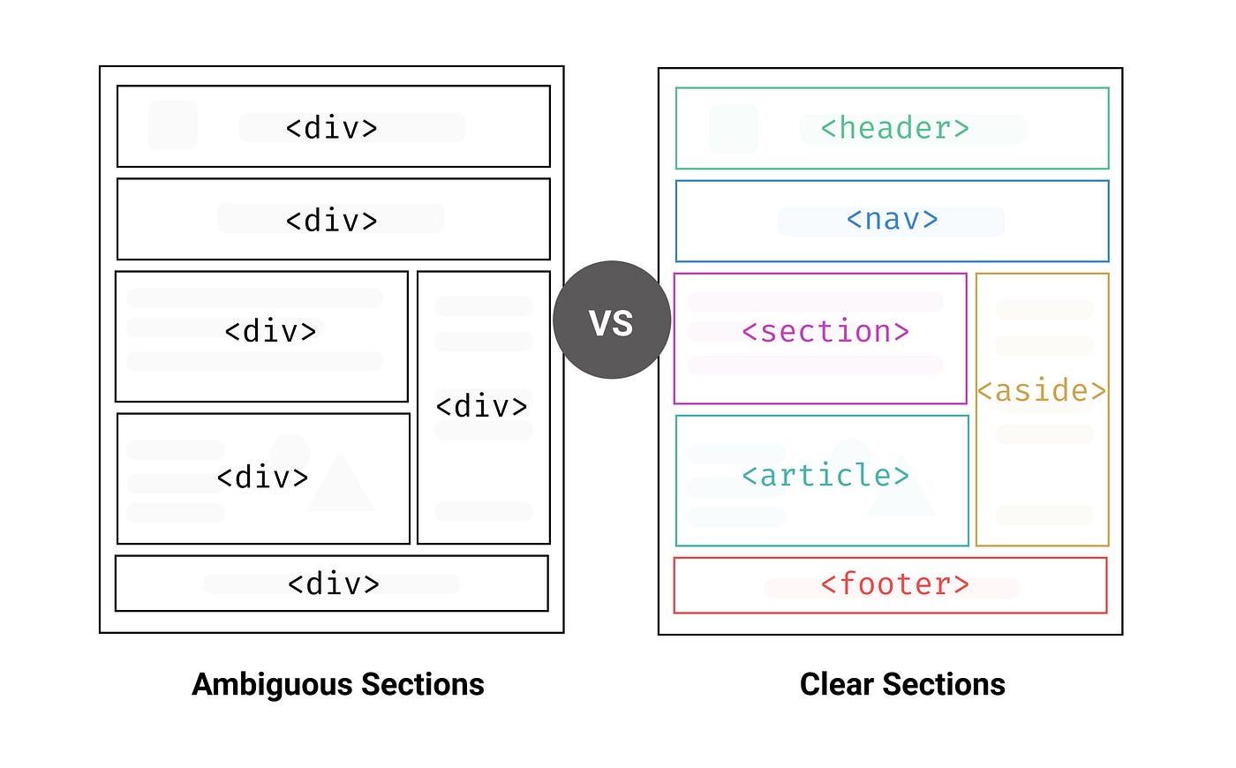
Semantic Elements in HTML
Many websites contain HTML code like <div id="nav"> <div class="header"> <div id="footer"> to indicate navigation, header, and footer.
In HTML, some semantic elements can be used to define different parts of a web page:
<footer>
<header>
<main>
<mark>
<nav>
<article>
<aside>
<details>
<figcaption>
<figure>
<section>
<summary>
<time>

Slide 24

HTML Links
Use the <a> element to define a link
Use the href attribute to define the link address
Use the target attribute to define where to open the linked document
Use the <img> element (inside <a>) to use an image as a link
Use the mailto: scheme inside the href attribute to create a link that opens the user's email program

Slide 25

HTML Links
Bookmarks
<p><a href="#C4">Jump to Chapter 4</a></p>
.
.
.
.
.
<h2 id="C4">Chapter 4</h2>
<p>This chapter explains ba bla bla</p>

Slide 26
HTML Links
Absolute vs Relative URL
There are two ways to specify the URL in the src attribute:
1. Absolute URL - Links to an external image that is hosted on another website. Example: src="https://www.w3schools.com/images/img_girl.jpg".
Notes: External images might be under copyright. If you do not get permission to use it, you may be in violation of copyright laws. In addition, you cannot control external images; it can suddenly be removed or changed.
2. Relative URL - Links to an image that is hosted within the website. Here, the URL does not include the domain name.
If the URL begins without a slash, it will be relative to the current page.
Example: src="img_girl.jpg".
If the URL begins with a slash, it will be relative to the domain.
Example: src="/images/img_girl.jpg".
Tip: It is almost always best to use relative URLs. They will not break if you change the domain.

Slide 27
HTML Images and Icon
Image
Basic tag and attributes
Image Map
The Picture Element
Icon
Step 1 – Copy the style link from any website (which provides this functionality) inside the head section
Example - Font Awesome CDN
Step 2 – Copy the desired icon link inside body section
Example – Font Awesome Icon

Slide 28

HTML Images and Icon
Image Map
An image map is an image with clickable areas.
<img src="workplace.jpg" alt="Workplace" usemap="#workmap"> <map name="workmap"> <area shape="rect" coords="34,44,270,350" alt="Computer" href="computer.htm"> <area shape="rect" coords="290,172,333,250" alt="Phone" href="phone.htm"> <area shape="circle" coords="337,300,44" alt="Coffee" href="coffee.htm"> </map>
credit w3schools

Slide 29
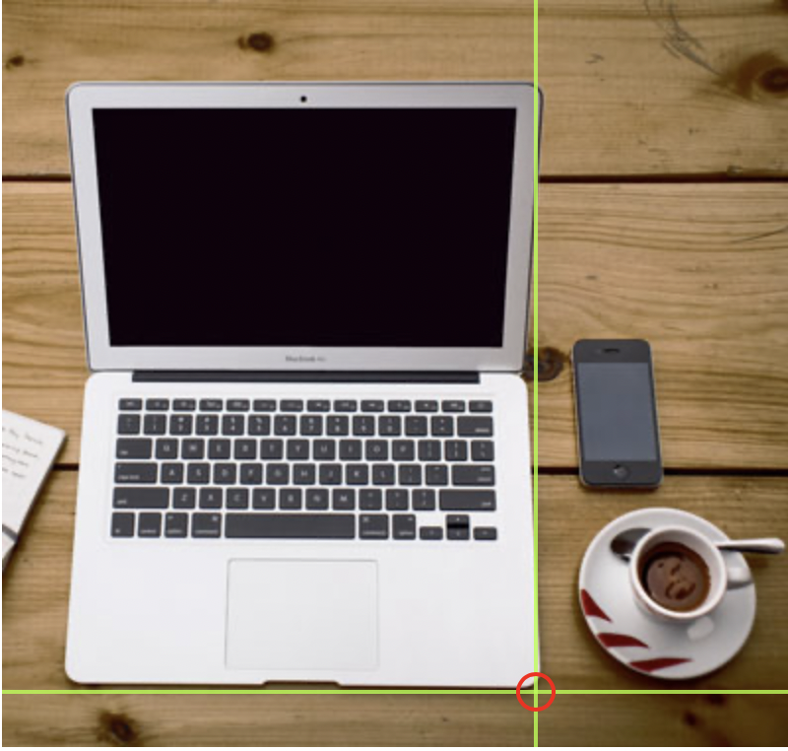

The coordinates 34,44 is located 34 pixels from the left margin and 44 pixels from the top
The coordinates 270,350 is located 270 pixels from the left margin and 350 pixels from the top
credit w3schools

Slide 30

The coordinates 34,44 is located 34 pixels from the left margin and 44 pixels from the top
The coordinates 270,350 is located 270 pixels from the left margin and 350 pixels from the top
credit w3schools

Slide 31
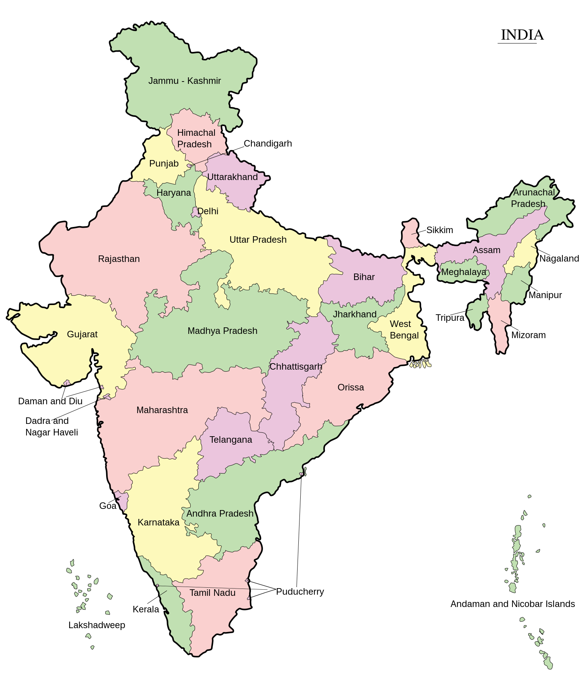
HTML Images and Icon
Image Map
An image map is an image with clickable areas.

Slide 32



HTML Images and Icon
The Picture Element
The HTML <picture> element allows you to display different pictures for different devices or screen sizes.
<picture> <source media="(min-width: 650px)" srcset="img_food.jpg"> <source media="(min-width: 465px)" srcset="img_car.jpg"> <img src="img_girl.jpg"> </picture>

Slide 33
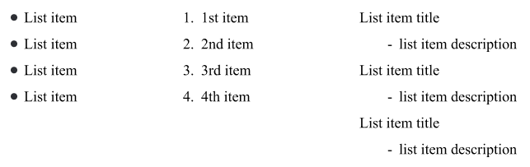
HTML List
Unordered
type
circle
Square
Disc
none
Ordered
type
1,2,3
a,b,c
A,B, C
i, ii, iii
I, II, III,
Description
Nested List
Unordered
Ordered
Description

Slide 34
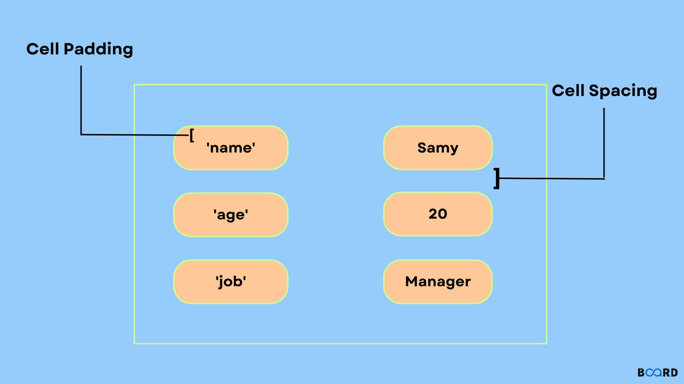
HTML Table

Slide 35
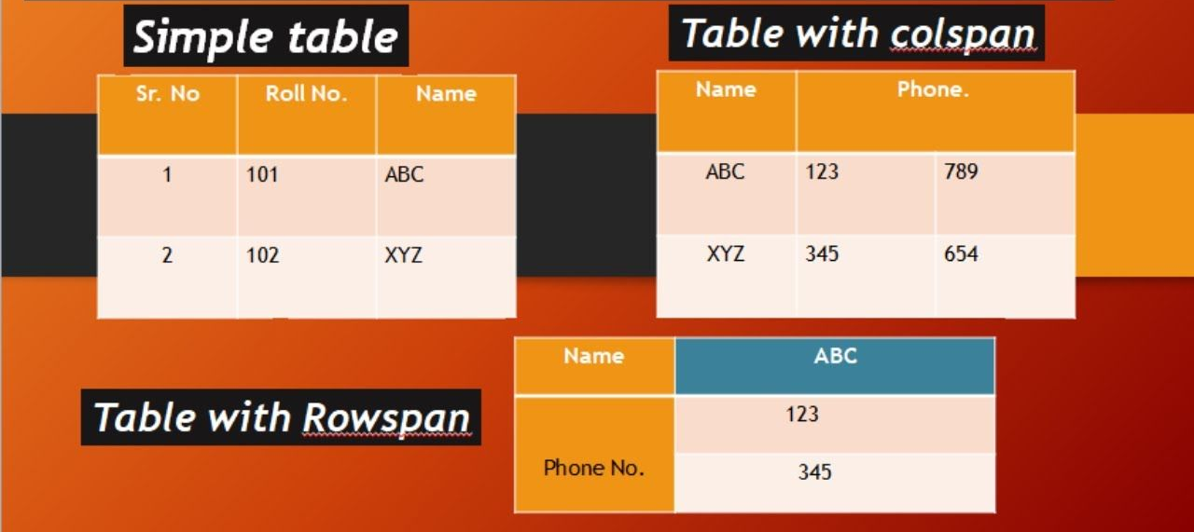
HTML Table

Slide 36
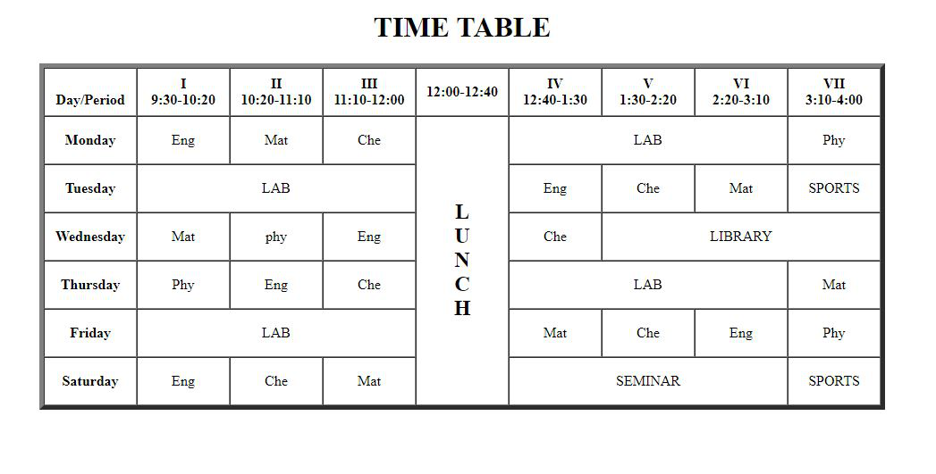
HTML Table

Slide 37
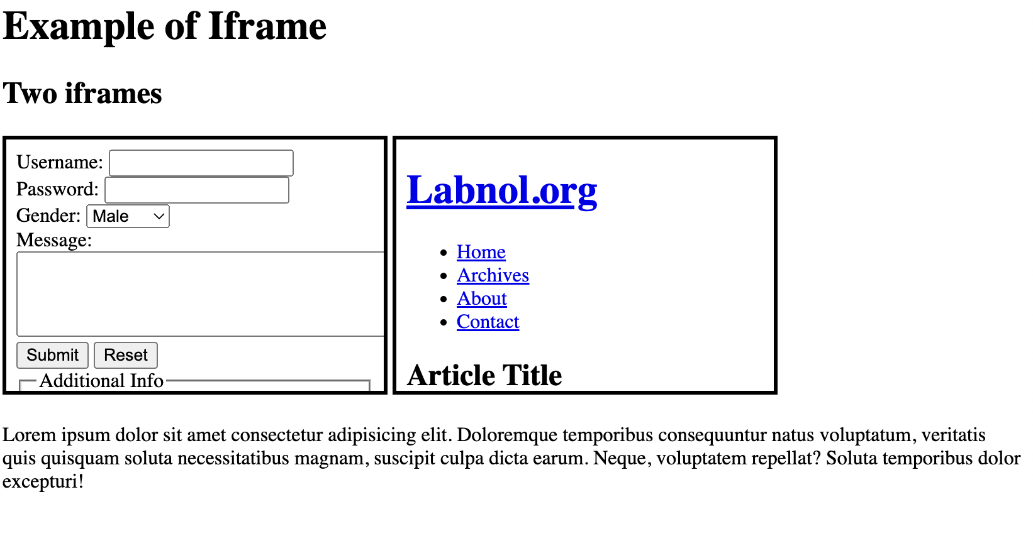
iFrame in HTML
HTML element used to embed another document within the current HTML document. It allows you to display content from another source, such as a web page, PDF document, video, or interactive application, within the context of your own web page.

Slide 38
Block level and Inline elements
A block-level element always starts on a new line, and the browsers automatically add some space (a margin) before and after the element.
A block-level element always takes up the full width available (stretches out to the left and right as far as it can)
Eg. <p>, <div>, <ul>, <form> etc
Note: The <div> element is often used as a container for other HTML elements.
An inline element does not start on a new line.
An inline element only takes up as much width as necessary.
Eg. <span>, <img>, <a> etc

Slide 39
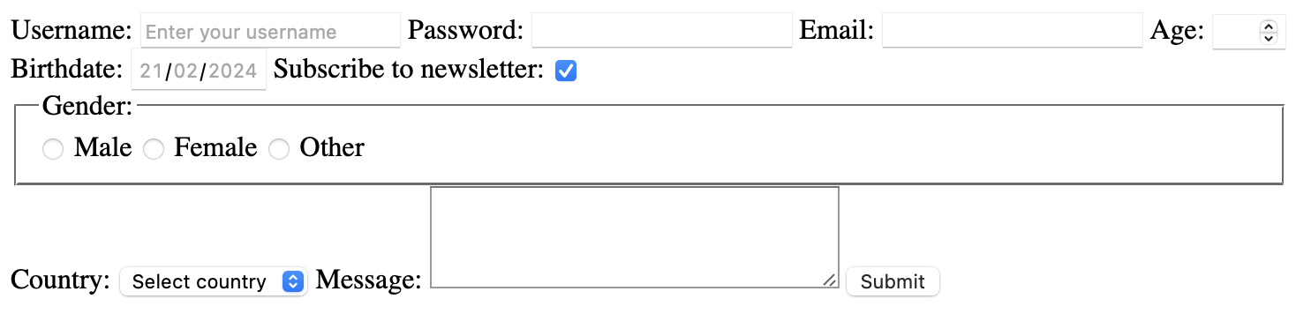
HTML Form

Slide 40
Get vs POST
GET:
Appends the form data to the URL in name/value pairs
NEVER use GET to send sensitive data! (the submitted form data is visible in the URL!)
The length of a URL is limited (2048 characters)
Useful for form submissions where a user wants to bookmark the result
GET is good for non-secure data, like query strings in Google
POST:
Appends the form data inside the body of the HTTP request (the submitted form data is not shown in the URL)
POST has no size limitations and can be used to send large amounts of data.
Form submissions with POST cannot be bookmarked.

Slide 41
Accessibility in HTML5
Accessibility in HTML5 refers to the practice of designing and coding web content in a way that ensures it is accessible (a good way to navigate and interact) to all users, including those with disabilities.
Semantic HTML Elements
Alternative Text
Keyboard Navigation
Create Good Link Text
Form attributes
etc

Slide 42
The W3C Markup Validation Service
A valid Web page is not necessarily a good web page, but an invalid Web page has little chance of being a good web page.
https://validator.w3.org

Slide 43
The W3C CSS Validation Service
https://jigsaw.w3.org/css-validator/
Note: If you want to validate your CSS style sheet embedded in an (X)HTML document, you should first check that the (X)HTML you use is valid.

Slide 44
HTML | CSS | Javascript
1. HTML to define the basic structure of web pages.
2. CSS to specify the layout of web pages
3. JavaScript to program the behavior of web pages

Slide 45
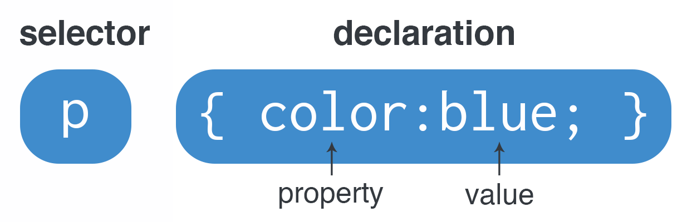
CSS (Cascading Style Sheets)
p
{ color: blue; }

Slide 46
Types of CSS or Ways to Insert CSS
External CSS
Internal CSS
Inline CSS

Slide 47
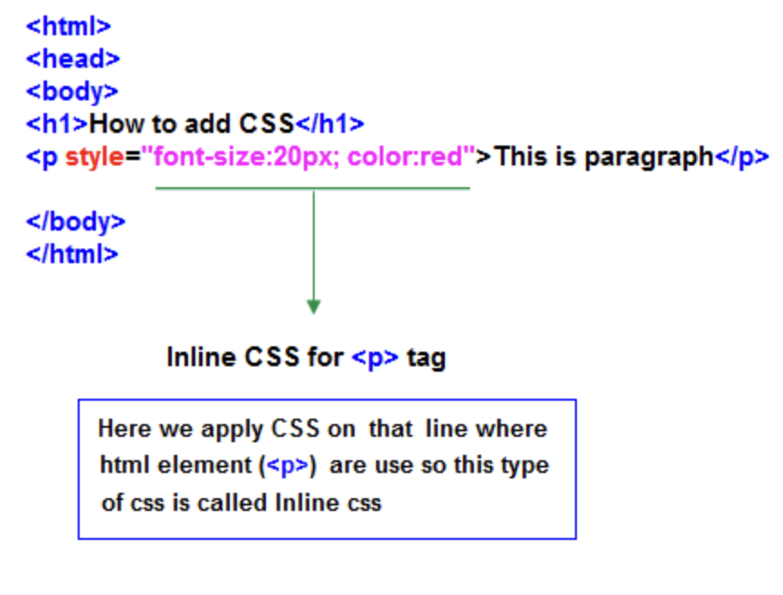
Inline CSS

Slide 48
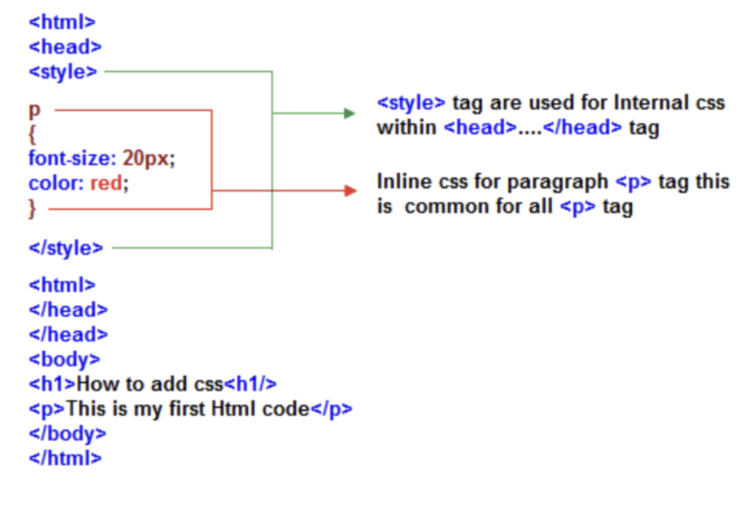
Internal CSS

Slide 49
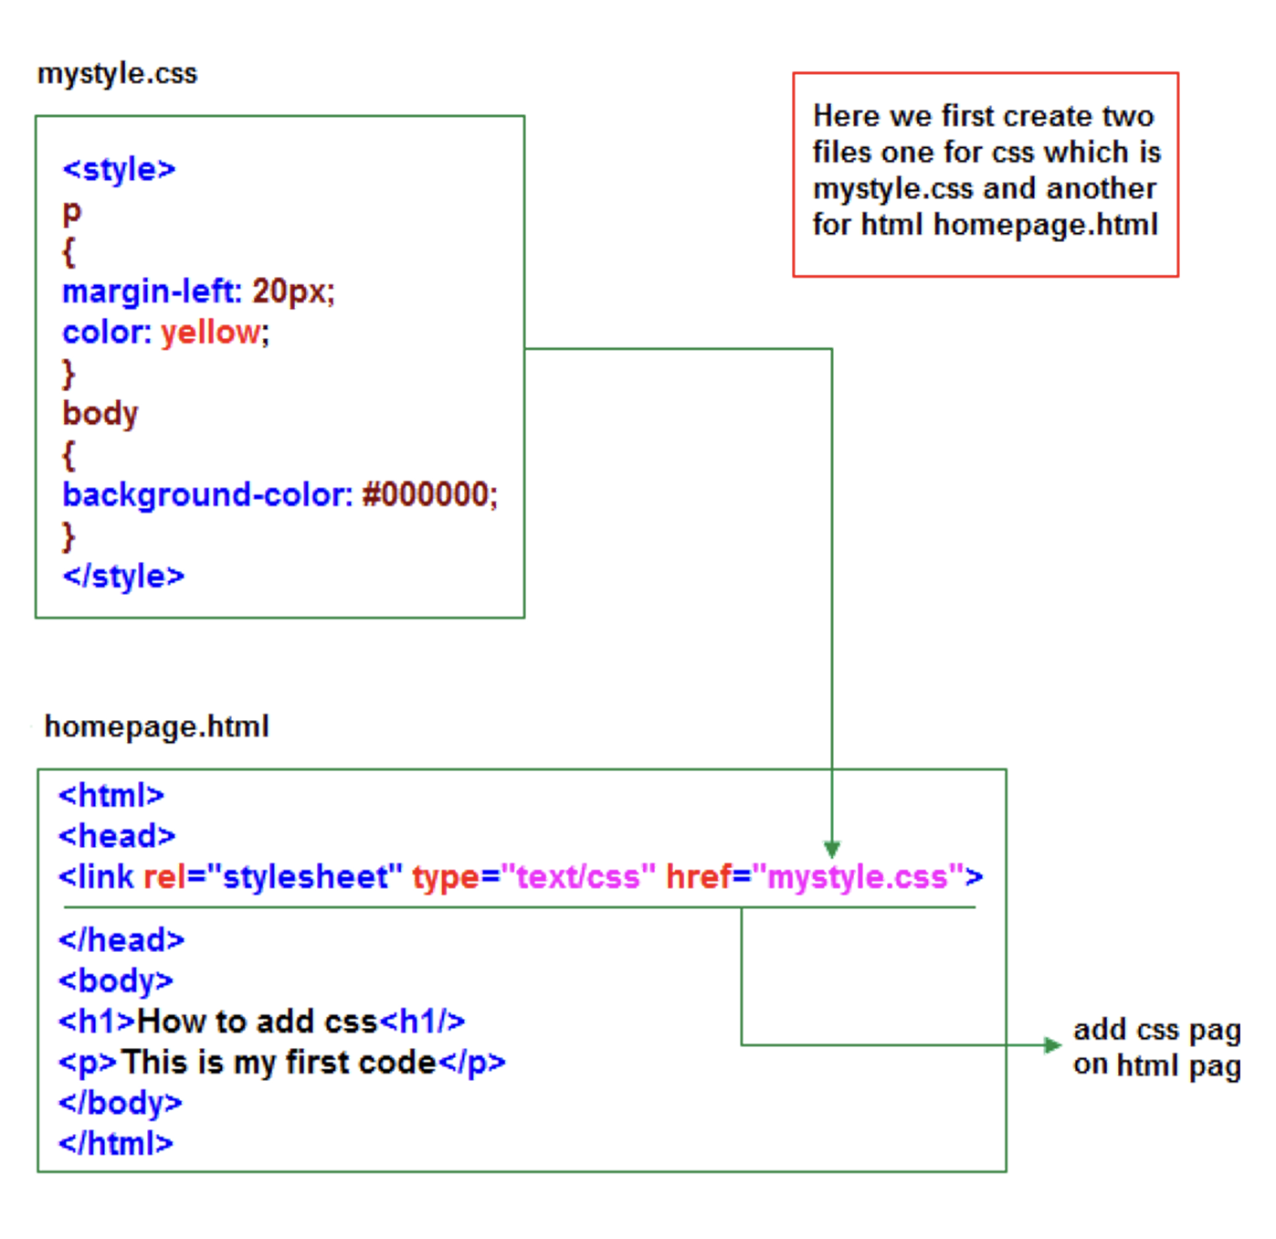
External CSS

Slide 50
HTML and CSS Comments
HTML
<!-- These paragraphs will be red -->
CSS
/*These paragraphs will be red */

Slide 51
CSS Selectors
CSS selectors are used to select the HTML elements you want to style.
CSS selectors are divided into five categories:
Simple selectors (select elements based on name, id, class)
Combinator selectors (select elements based on a specific relationship between them)
Pseudo-class selectors (select elements based on a certain state)
Pseudo-elements selectors (select and style a part of an element)
Attribute selectors (select elements based on an attribute or attribute value)

Slide 52
Simple selectors
p { text-align: center; color: red; }
p,h1 { text-align: center; color: red; }
Single Selector
Group Selector

Slide 53
ID selector
The id attribute is used to specify a unique id for an HTML element
The value of the id attribute must be unique within the HTML document
The id attribute is used by CSS and JavaScript to style/select a specific element
The value of the id attribute is case-sensitive
The id attribute is also used to create HTML bookmarks
JavaScript can access an element with a specific id with the getElementById() method

Slide 54
Class selector
The HTML class attribute specifies one or more class names for an element
Classes are used by CSS and JavaScript to select and access specific elements
The class attribute can be used on any HTML element
The class name is case-sensitive
Different HTML elements can point to the same class name
JavaScript can access elements with a specific class name with the getElementsByClassName() method

Slide 55
Combinator selectors
There are four different combinators in CSS:
descendant selector (space)
child selector (>)
adjacent sibling selector (+)
general sibling selector (~)

Slide 56
Pseudo-class selectors
A pseudo-class is used to define a special state of an element.
/* unvisited link */ a:link { color: #FF0000; } /* visited link */ a:visited { color: #00FF00; }
Syntax
div:hover p { display: block; }
selector:pseudo-class { property: value; }

Slide 57
Pseudo-element selectors
A CSS pseudo-element is used to style specified parts of an element.
Syntax
p::first-line { color: #ff0000; font-variant: small-caps; }
selector::pseudo-element { property: value; }

Slide 58
Attribute selectors
It is possible to style HTML elements that have specific attributes or attribute values.
a[target] { background-color: yellow; }
a[target="_blank"] { background-color: yellow; }

Slide 59
CSS Colors
There are four common ways to apply colors
Direct Color Name
<h1 style="color:Red;">Hello World</h1>
RGB (Red, Green, Blue)
rgb(255,255,255)
HEX
#RRGGBB, #ff6678
HSL (hue, saturation, and lightness) hsl(0, 100%, 50%)
Hue is a degree on the color wheel from 0 to 360. 0 is red, 120 is green, and 240 is blue.
Saturation is a percentage value. 0% means a shade of gray, and 100% is the full color.
Lightness is also a percentage. 0% is black, 50% is neither light or dark, 100% is white

Slide 60
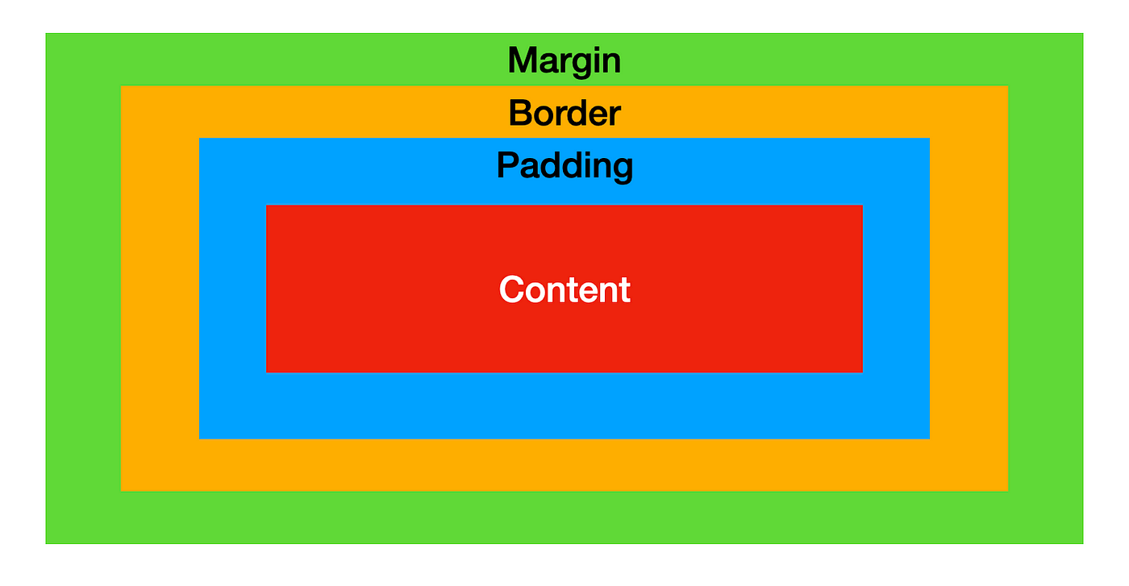
CSS Box Model

Slide 61
CSS Box Model
All HTML elements can be considered as boxes.
Width and Height of an Element
Note: When you set the width and height properties of an element with CSS, you just set the width and height of the content area.
To calculate the total width and height of an element, you must also include the padding and borders.
Note: The margin property also affects the total space that the box will take up on the page, but the margin is not included in the actual size of the box. The box's total width and height stops at the border.

Slide 62
CSS Fonts
The shorthand font property, combines several font-related properties into one. The order of the values in the shorthand font property is as follows:
font-style: Specifies the font style (e.g., italic).
font-variant: Specifies the font variant (e.g., small-caps).
font-weight: Specifies the font weight (e.g., bold).
font-size/line-height: Specifies the font size and optional line height (e.g., 12px/30px).
font-family: Specifies the font family (e.g., Georgia, serif).
Note: The font-size and font-family values are required. If one of the other values is missing, their default value are used.

Slide 63
Bootstrap
Bootstrap is a free front-end framework for faster and easier web development.
Bootstrap includes HTML and CSS based design templates for typography, forms, buttons, tables, navigation, modals, image carousels and many other, as well as optional JavaScript plugins.
Bootstrap also gives you the ability to easily create responsive designs.

Slide 64
Bootstrap Versions
Bootstrap 5 (released 2021) is the newest version with new components, faster stylesheet and more responsiveness. However, Internet Explorer 11 and down is not supported.
Previous versions are Bootstrap 3 & 4.
Bootstrap 5 has switched to vanilla JavaScript instead of jQuery.

Slide 65
Where to Get Bootstrap 5?
There are two ways to start using Bootstrap 5 on your own website.
Include Bootstrap 5 from a CDN.
Download Bootstrap 5 from www.getbootstrap.com

Slide 66
Advantage of Bootstrap 5 from CDN
Many users already have downloaded Bootstrap 5 from jsDelivr when visiting another site. As a result, it will be loaded from cache when they visit your site, which leads to faster loading time.
Also, most CDN's will make sure that once a user requests a file from it, it will be served from the server closest to them, which also leads to faster loading time.

Slide 67

Bootstrap 5 Containers
Containers are used to pad the content inside of them, and there are two container classes available:
The .container class provides a responsive fixed-width container.
The .container-fluid class provides a full-width container, spanning the entire width of the viewport.

Slide 68
Grid System
It consists of a series of rows and columns organized into a grid, which provides a structured way to arrange content on a web page.
Here are the key components of the grid system in Bootstrap:
Container: The outermost element that wraps all the rows and columns. It provides a fixed-width container for your content. Bootstrap offers two types of containers: .container for fixed-width containers and .container-fluid for full-width containers.
Row:
Column: Columns are the building blocks of the grid system. They are placed inside rows and are used to divide the horizontal space within a row. Bootstrap provides a set of predefined column classes, such as .col-, .col-sm-, .col-md-, .col-lg-, and .col-xl-, which define the width of the column at different breakpoints.

Slide 69
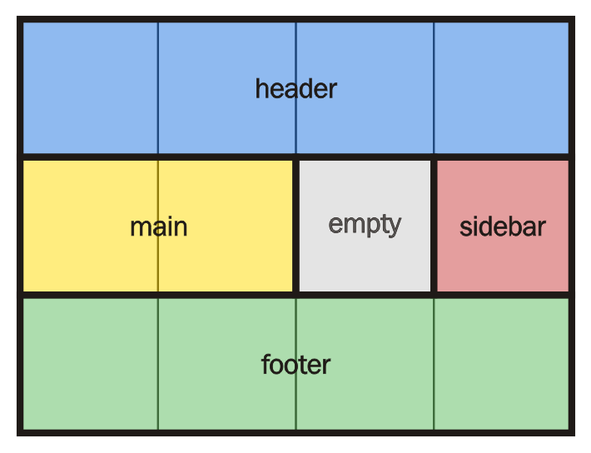
Grid System

Slide 70
Basic functionality of JavaScript
JavaScript can "display" data in different ways.
Writing into an HTML element, using innerHTML.
The innerHTML property defines the HTML content
Writing into the HTML output using document.write().
Using document.write() after an HTML document is loaded, will delete all existing HTML.
The document.write() method should only be used for testing.
Writing into an alert box, using window.alert().
Writing into the browser console, using console.log().
For debugging purposes, you can call the console.log() method in the browser to display data.

Slide 71
JavaScript can be included in an HTML document in several different ways; the most common are :
Inline JavaScript
<button onclick="alert('Hello, world!')">Click me</button>
Internal JavaScript
Inside <body>
Inside <head>
<script>
// JavaScript code here
</script>
<script>
// JavaScript code here
</script>
External JavaScript
<script src="script.js"></script>

Slide 72
Common ways to select HTML element
getElementById()
getElementsByClassName()
getElementsByName()
getElementsByTagName()

Slide 73
JavaScript Variables
Variables can be declared in 4 ways:
Automatically
Using var
Using let
Using const
a = 5;
var a = 5;
let a = 5;
const a = 5;

Slide 74
Block Scope
Before ES6 (2015), JavaScript did not have Block Scope.
JavaScript had Global Scope and Function Scope.
ES6 introduced the two new JavaScript keywords: let and const.
These two keywords provided Block Scope in JavaScript.
Variables declared with the var always have Global Scope or Function Scope.
Variables declared with the var keyword can NOT have block scope.
Variables declared with var inside a { } block can be accessed from outside the block.

Slide 75
Introduced
var - pre ES2015
let - ES2015 (ES6)
const – ES2015 (ES6)

Slide 76
Declaration
var a; // allowed let b; // allowed const c; // not allowed SyntaxError: Missing initializer in const declaration
const c = 10 ; // allowed

Slide 77
Initialization
Same line Initialization :
Later Initialization :
var a; a = 10; // allowed let b; b = 20; // allowed const c; c = 30; // not allowed SyntaxError: Missing initializer in const declaration
var a = 10, let b = 20; const c = 30;

Slide 78
Redeclaration
var a = 10; var a = 20; //its possible to with var let b = 10; let b = 20; //its not possible to with let SyntaxError: Identifier 'b' has already been declared const c = 10; const c = 20; //its not possible with const SyntaxError: Identifier 'c' has already been declared

Slide 79
Redeclaring Var
Variables defined with var can be redeclared.
Redeclaring a variable using the var keyword can impose problems.
var x = 10;
// Here x is 10
{
var x = 2;
// Here x is 2
}
// Here x is 2
If you re-declare a JavaScript variable declared with var, it will not lose its value.
var a = 5; var a; // var is still 5

Slide 80
Reinitialization
var a = 10; //declared once a = 20; //reintialized again --> its possible with var let b = 10; //declared once b = 20; //reintialized again --> its possible with let const c = 10; //declared once c = 20; //reintialized again --> its NOT possible with let, TypeError: Assignment to constant variable.

Slide 81
Scope
a) Functional Scope: declare greeting variable without var
When we don’t declare variables without any var, let and const , variables gets hoisted globally .
function wishFoofi() { greeting = “Hello, foofi!”; // hoisted globally console.log(greeting); } wishFoofi(); console.log(greeting); // Hello, foofi!
Output: Hello, foofi! Hello, foofi!

Slide 82
Scope
a) Functional Scope: declare greeting variable with var now
function wishFoofi() { var greeting = "Hello, foofi!"; //greeting remained functional scoped console.log(greeting); }
Output: Hello, foofi! ReferenceError: greeting is not defined

Slide 83
Scope
{ var x = 10; } console.log(x); // output 10 { let y = 20; } console.log(y); // output : ReferenceError: y is not defined { const z = 30; } console.log(z); // output : ReferenceError: z is not defined
b) Block Scope

Slide 84
Hoisted
console.log(x); // Outputs 'undefined' var x = 10; // Assignment remains in its original position
let and const : Not Hoisted*
* variables with let and const are also hoisted but at the top of block scope and they are not assigned with undefined.

Slide 85
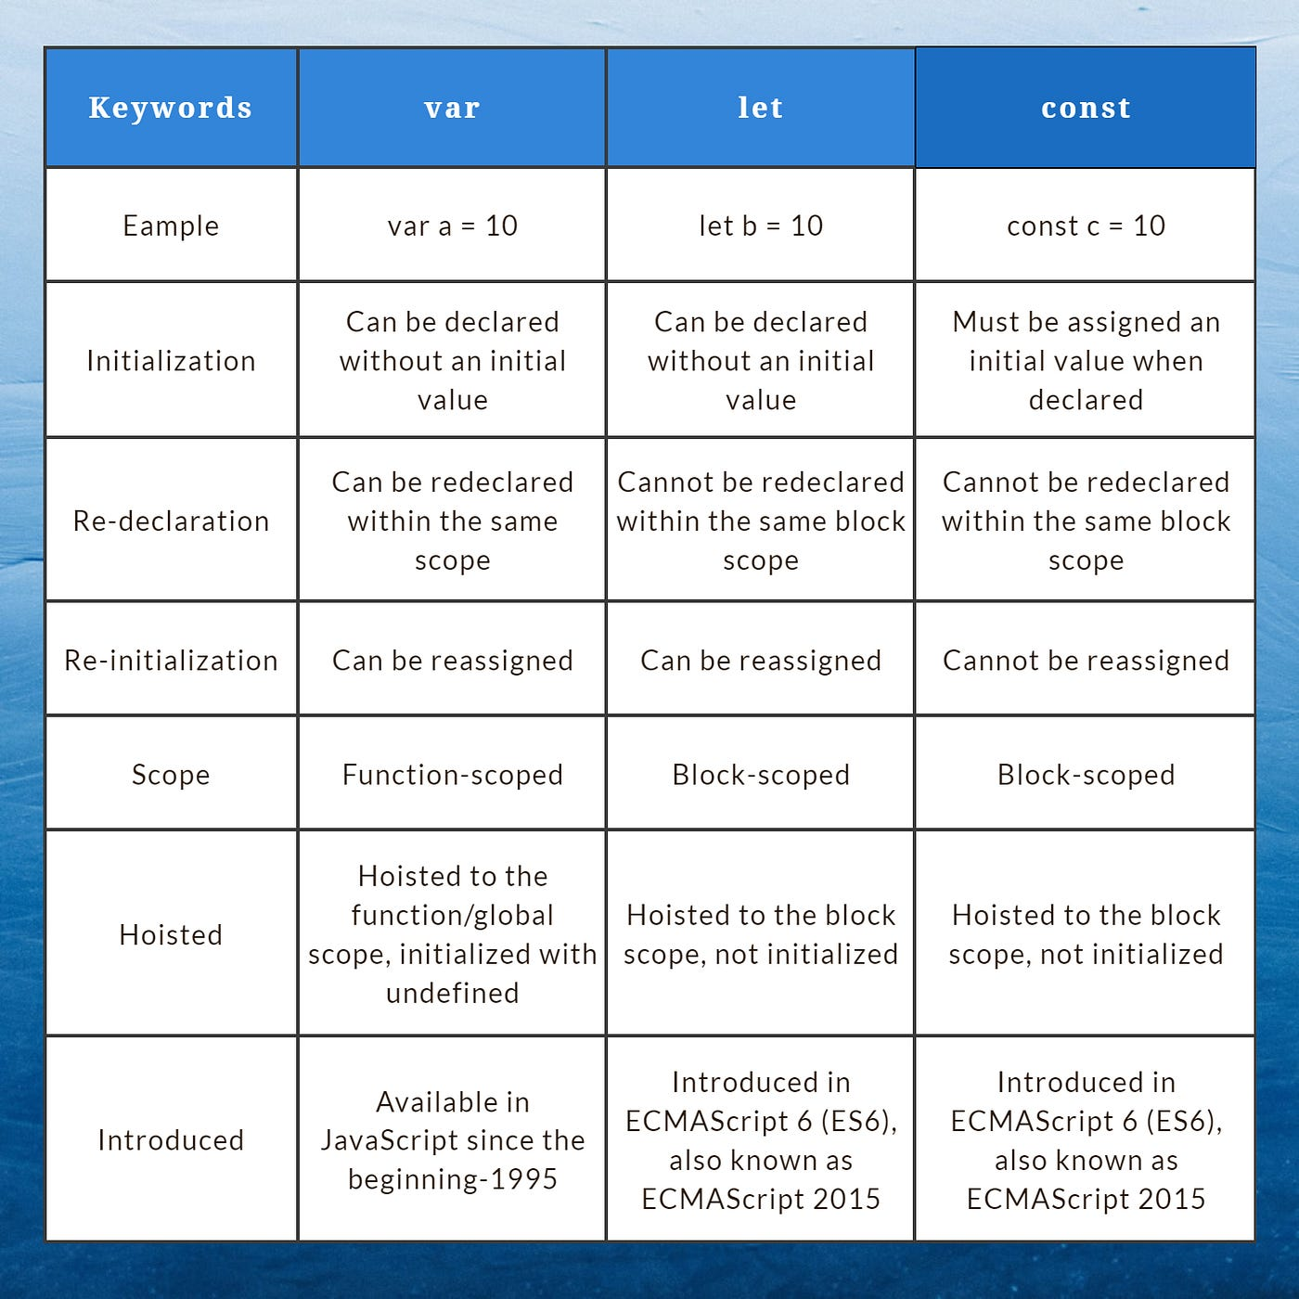

Slide 86
JavaScript Datatypes
var, let, and const are not data types themselves; they are keywords used for variable declaration.
Data types in JavaScript are the types of values that variables can hold, such as numbers, strings, booleans, objects, arrays, etc.
When you write something like var a = 10;, a can hold a number value (10 in this case), so we say that a is a variable holding a numeric literal.
In summary, while in C and C++, we explicitly specify the data type of a variable when declaring it, in JavaScript, we declare variables using keywords like var, let, or const, and the data type of a variable is determined by the value it holds.
In JavaScript:

Slide 87
JavaScript Data Types
JavaScript has 8 Datatypes
1. String 2. Number 3. Bigint 4. Boolean 5. Undefined 6. Null 7. Symbol 8. Object
The Object Datatype
The object data type can contain:
Primitive values
Other objects
Arrays
Functions
Dates
Symbols and more

Slide 88
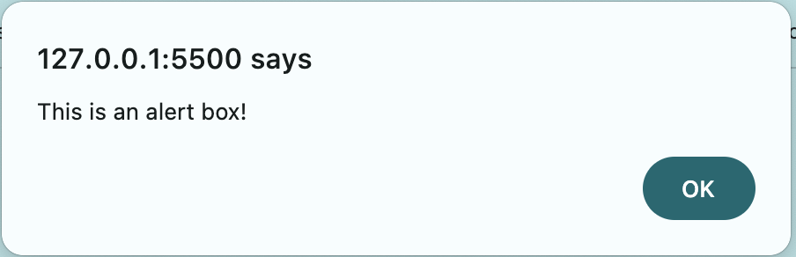
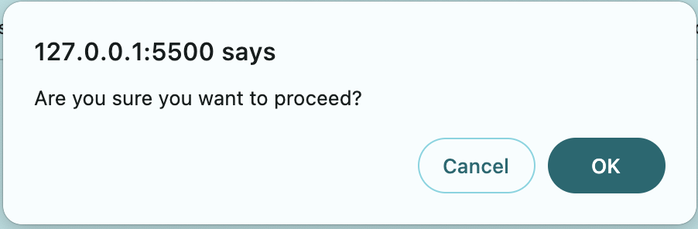
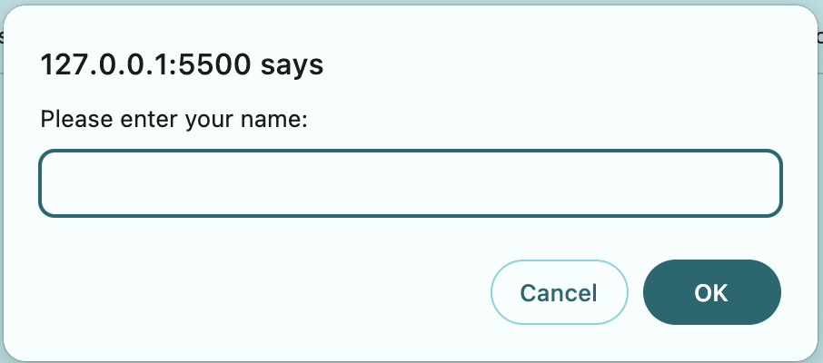
Pop-up boxes in JavaScript
Alert Box
Confirm Box
Prompt Box

Slide 89
JavaScript Form Validation
Forms can be validated using HTML, and JavaScript.
HTML Validation: HTML5 introduced several built-in validation attributes for form inputs such as required, min, max, pattern, etc.
JavaScript Validation: You can use JavaScript to implement custom validation logic beyond what HTML provides. This allows you to perform complex validation tasks, such as validating the format of input data, checking for uniqueness, or interacting with external data sources for validation.
CSS Role: While CSS itself cannot perform form validation, it can be used to enhance the visual feedback of validation errors. For example, you can style invalid form inputs using the :invalid and :valid pseudo-classes to provide visual cues to users.

Slide 90
Regular Expression
Regular expressions in JavaScript, also known as regex or regexp, are a sequence of characters that form a search pattern.
1. Creating Regular Expression
Regular expressions in JavaScript can be created using the RegExp constructor or by using a regex literal enclosed in forward slashes (/).
// Using RegExp constructor
const regex1 = new RegExp('pattern’);;
// Using regex literal
const regex2 = /pattern/;

Slide 91
2. Matching Patterns
Regular expressions are used with string methods like test() and match() to check if a pattern matches a string or to extract substrings that match the pattern.
Example:
const str = 'Hello, world!’;
const pattern = /hello/i; // Case-insensitive match
console.log(pattern.test(str)); // Output: true
console.log(str.match(pattern)); // Output: ["Hello”]

Slide 92
3. Modifiers
Regular expressions support modifiers that affect how a pattern is matched, such as:
i: Case-insensitive match
g: Global match (find all matches, not just the first)
m: Multiline match
Example:
const str = 'Apple, apple, APPLE’;
const pattern = /apple/ig; // Case-insensitive, global match
console.log(str.match(pattern)); // Output: ["Apple", "apple", "APPLE"]
Replace
str.replace(/apple/i, ”GEHU");

Slide 93
Regular Expression Patterns
Brackets are used to find a range of characters:
Expression | Description
[abc] | Find any of the characters between the brackets
[0-9] | Find any of the digits between the brackets
(x|y) | Find any of the alternatives separated with |
Metacharacters are characters with a special meaning:
Metacharacter | Description
\d | Find a digit
\s | Find a whitespace character
\b | Find a match at the beginning of a word like this: \bWORD, or at the end of a word like this: WORD\b
\uxxxx | Find the Unicode character specified by the hexadecimal number xxxx

Slide 94
Regular Expression Patterns
Quantifiers define quantities:
Quantifier | Description
n+ | Matches any string that contains at least one n
n* | Matches any string that contains zero or more occurrences of n
n? | Matches any string that contains zero or one occurrences of n

Slide 95
DOM – Document Object Model
The DOM is a W3C (World Wide Web Consortium) standard.
The DOM (Document Object Model) is a programming interface provided by web browsers that represents HTML, XML, and XHTML documents as a structured tree of objects.
It defines the logical structure of documents and how a document is accessed and manipulated.
When a web page is loaded, the browser creates a Document Object Model of the page.

Slide 96
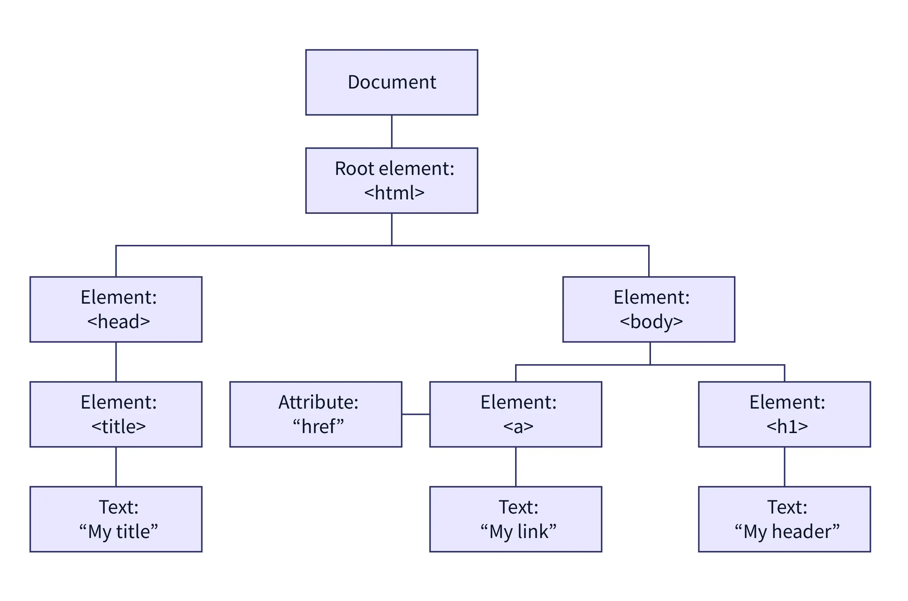
HTML DOM
Note:
window object represents the browser window and provides browser-related functionality such as navigating to URLs (window.location), managing browser history (window.history), setting timeouts (window.setTimeout), and more., the document object represents the HTML document loaded in that window and allows manipulation of its content.

Slide 97
Manipulation Using DOM
Below are some of the functionality that JavaScript can perform
JavaScript Can Change HTML Content
JavaScript Can Change HTML Attribute Values
JavaScript Can Change HTML Styles (CSS)
JavaScript Can Hide HTML Elements
JavaScript Can Show HTML Elements
JavaScript can remove existing HTML elements and attributes
JavaScript can add new HTML elements and attributes
JavaScript can react to all existing HTML events in the page
JavaScript can create new HTML events in the page

Slide 98
JQuery ($)
What is jQuery?
Lightweight JavaScript Library.
Simplifies JavaScript programming.
Write Less, Do More.
Browser independent.
Used by Google, Microsoft, IBM, Netflix
Features:
HTML/DOM manipulation
CSS manipulation
HTML event methods
Effects and animations
AJAX etc

Slide 99
Where to get JQuery?
There are two ways to include JQuery on your own website.
Download the JQuery library.
Production Version – minify and compressed
Development Version – uncompressed and human readable
Include JQuery from a CDN say Google.

Slide 100
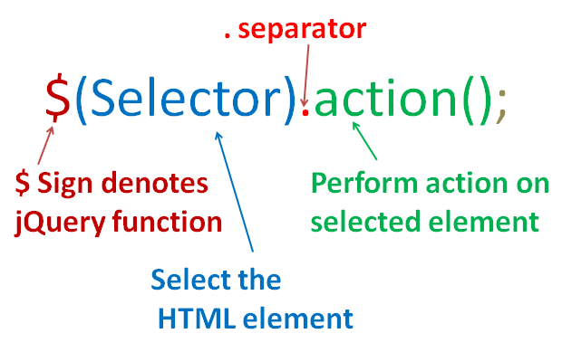
Syntax
JavaScript JQuery
document.getElementById("id"); $("#id");

Slide 101
Syntax
$(document).ready(function(){ // jQuery methods go here... });
OR
$(function(){ // jQuery methods go here... });

Slide 102
Types of Selectors
Followings are the three major types of selectors in JQuery
Element Selector
ID selector
Class Selector

Slide 103
AJAX
Asynchronous JavaScript And XML.
AJAX is the art of exchanging data with a server and updating parts of a web page - without reloading the whole page.
Examples of applications using AJAX are Gmail, Google Maps, YouTube, and Facebook tabs.
With the jQuery AJAX methods, you can request text, HTML, XML, or JSON from a remote server using both HTTP Get and HTTP Post - And you can load the external data directly into the selected HTML elements of your web page!

Slide 104

Note:
Writing regular AJAX code can be complex due to variations in syntax across different browsers. This requires additional code to handle browser compatibility issues. However, jQuery simplifies AJAX implementation by providing a unified syntax, allowing developers to write AJAX functionality with just one line of code.

Slide 105
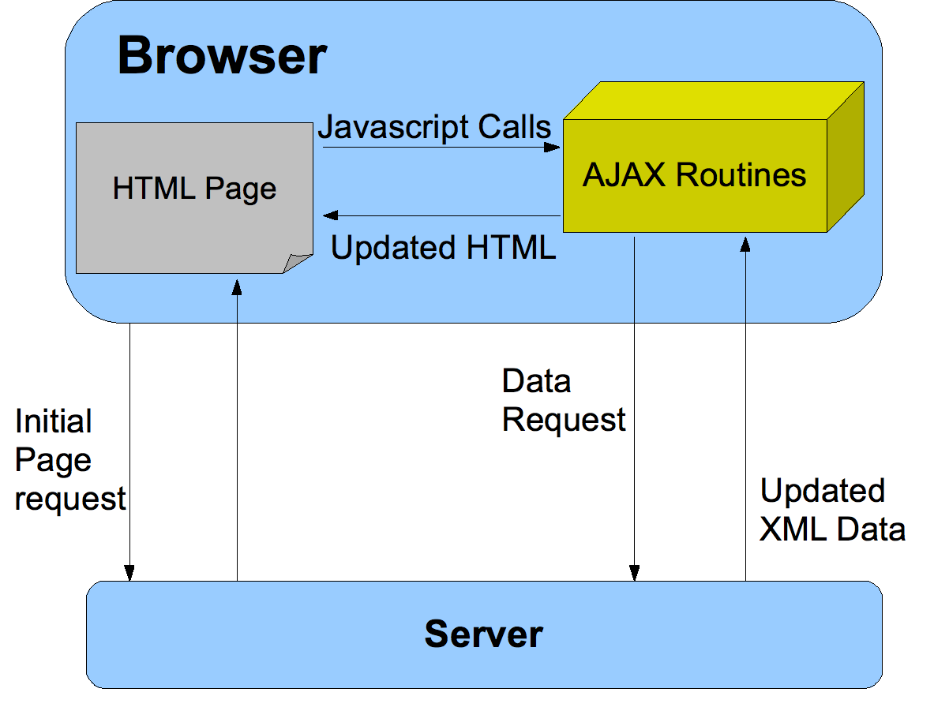

Slide 106
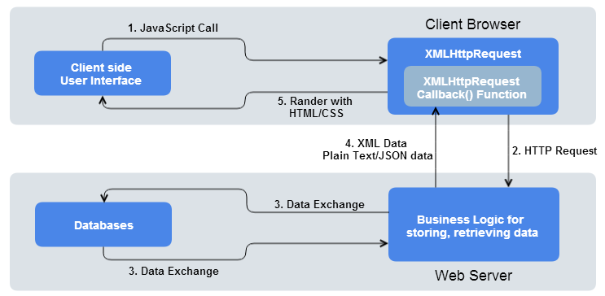

Slide 107
load()
$(selector).load(URL,data,callback);
Data – send additional data to the server along with the request.
The callback function can have different parameters:
responseTxt - contains the resulting content if the call succeeds
statusTxt - contains the status of the call
xhr - contains the XMLHttpRequest object
credit w3schools

Slide 108
get()
$.get(URL,callback);
The callback function can have different parameters:
data - holds the content of the page requested,
status - holds the status of the request.
credit w3schools

Slide 109
XML
post()
$.post(URL,data, callback);
Data – send additional data to the server along with the request.
The callback function can have different parameters:
data - holds the content of the page requested,
status - holds the status of the request.
credit w3schools

Slide 110
XML
XML stands for eXtensible Markup Language
XML is a markup language much like HTML
XML was designed to store and transport data
XML was designed to be self-descriptive
XML is a W3C Recommendation
The Difference Between XML and HTML
XML was designed to carry data - with focus on what data is
HTML was designed to display data - with focus on how data looks
XML tags are not predefined like HTML tags.
credit w3schools

Slide 111
XML is Extensible
We can add our own tags
Most XML applications will work as expected even if new data is added (or removed).
<note> <to>Tove</to> <from>Jani</from> <heading>Reminder</heading> <body>Don't forget me this weekend!</body> </note>
<note> <date>2015-09-01</date> <hour>08:30</hour> <to>Tove</to> <from>Jani</from> <body>Don't forget me this weekend!</body> </note>
credit w3schools

Slide 112
XML Syntax Rules
XML Documents Must Have a Root Element
The XML Prolog
<?xml version="1.0" encoding="UTF-8"?>
The XML prolog is optional. If it exists, it must come first in the document.
All XML Elements Must Have a Closing Tag
XML Tags are Case Sensitive
XML Elements Must be Properly Nested
XML Attribute Values Must Always be Quoted
White-space is Preserved in XML
credit w3schools

Slide 113
XML Syntax Rules
Entity References
Some characters have a special meaning in XML.
If you place a character like "<" inside an XML element, it will generate an error because the parser interprets it as the start of a new element.
This will generate an XML error:
<message>salary < 1000</message>
To avoid this error, replace the "<" character with an entity reference:
<message>salary &lt; 1000</message>
credit w3schools

Slide 114
Well Formed vs Valid XML Documents
An XML document with correct syntax is called "Well Formed".
A "well formed" XML document is not the same as a "valid" XML document.
A "valid" XML document must be well formed. In addition, it must conform to a document type definition.
There are two different document type definitions that can be used with XML:
DTD - The original Document Type Definition
XML Schema - An XML-based alternative to DTD
credit w3schools

Slide 115
DTD
DTD
A DTD defines the structure and the legal elements and attributes of an XML document.
Note.dtd
<?xml version="1.0" encoding="UTF-8"?> <!DOCTYPE note SYSTEM "Note.dtd"> <note> <to>Tove</to> <from>Jani</from> <heading>Reminder</heading> <body>Don't forget me this weekend!</body> </note>
<!DOCTYPE note [ <!ELEMENT note (to,from,heading,body)> <!ELEMENT to (#PCDATA)> <!ELEMENT from (#PCDATA)> <!ELEMENT heading (#PCDATA)> <!ELEMENT body (#PCDATA)> ]>
credit w3schools

Slide 116
XML Schema
XML Schema
An XML Schema describes the structure of an XML document, just like a DTD.
<xs:element name="note"> <xs:complexType> <xs:sequence> <xs:element name="to" type="xs:string"/> <xs:element name="from" type="xs:string"/> <xs:element name="heading" type="xs:string"/> <xs:element name="body" type="xs:string"/> </xs:sequence> </xs:complexType> </xs:element>
credit w3schools

Slide 117
Why XML Schemas are More Powerful than DTD?
XML Schemas are written in XML
XML Schemas are extensible to additions
XML Schemas support data types
It is easier to convert data between different data types
XML Schemas support namespaces
You don't have to learn a new language
You can use your XML editor to edit your Schema files
You can use your XML parser to parse your Schema files
You can manipulate your Schemas with the XML DOM
You can transform your Schemas with XSLT
credit w3schools

